Slide 1
Schizophrenia & Brief Psychotic Disorder
A. de Santiago, D. Thompson-Hall , H. Hagen, J. Rodriguez, & S. Rogers,
PSY 410
University of Phoenix
February 8, 2008
Dr. M. Jones

Slide 2
Introduction
Doris

Slide 3
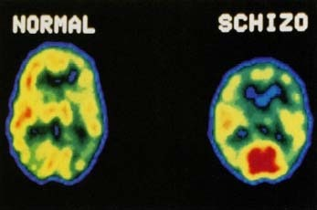
What are the characteristics of Schizophrenia?
Stephanie

Slide 4

What are the symptoms for a Brief Psychotic Disorder?
Stephanie

Slide 5
Treatment Options for Schizophrenia
jENNY

Slide 6
Treatments for A Brief Psychotic Disorder
jENNY

Slide 7
Differences between the two disorders
Schizophrenia
Brief Psychotic Disorder
JENNY

Slide 8
How can the legal system affect schizophrenia?
HEATHER

Slide 9
Can the Legal System be influenced by Schizophrenia?
In what way
How?
Brief examples
HEATHER

Slide 10
A specific case where the legal system was influenced by schizophrenia
HEATHER
Research to find an exact case where a verdict or law was changed because someone had schizophrenia

Slide 11

How can the Legal System affect a Brief Psychotic Disorder?
aRLY

Slide 12

Types of Crimes or incidences specifically tied to Schizophrenia
ARLY

Slide 13
Types of Crimes that have been tied to a brief psychotic disorder
ARLY

Slide 14

Can a brief Psychotic Disorder affect the legal System?
Stephanie

Slide 15
Conclusion
DORIS

Slide 16
Resources

